Slide 1
TRIBAL FOREST PROTECTION ACT OF 2004
ACQUISITIONS WEBINAR
NAVIGATING
CONTRACTS AND AGREEMENTS
BETWEEN TRIBES AND USFS
November 1, 2018
9:00 am-11:00 am Pacific Time
12:00 pm -2:00 pm (EDT)♦ 10:00 am -12:00 pm (MDT)

Slide 2
Objectives
Discuss mechanisms for contracts and agreements on TFPA projects.
Share Pros, Cons, Success Stories and Lessons Learned on partnerships between Tribes and USFS.
Provide perspectives on obstacles and jointly develop solutions.

Slide 3
Agenda
Description | Presenter
Welcome, Introductions, and Webinar Objectives | Stephanie Lucero, TFPA Workshop Coordinator
Overview of TFPA in Terms of Acquisitions | Intertribal Timber Council
Contracts between Tribes and USFS | Gavin Smith, WO AQM Procurement Analyst
Partnering with Agreements and Grants | Allison Leiman, National G&A Policy Specialist
Facilitated discussion: | All Stephanie Lucero, TFPA Workshop Coordinator
Wrap up and Next Steps | Stephanie Lucero, TFPA Workshop Coordinator
Adjourn | All

Slide 4
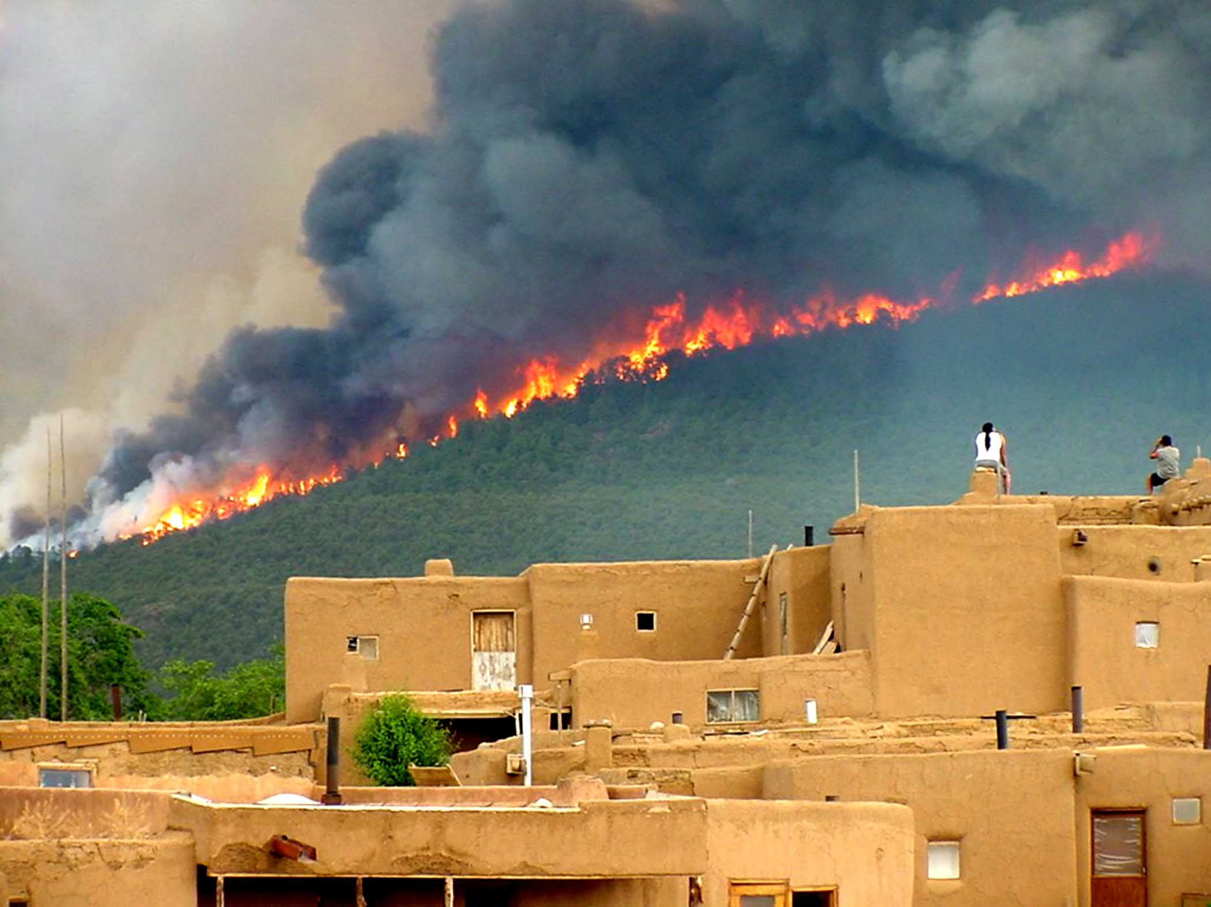
The History of TFPA: The West Was On Fire
Taos Photo 2003 by Ignacio Peralta, Photo courtesy of the Forest Service

Slide 5
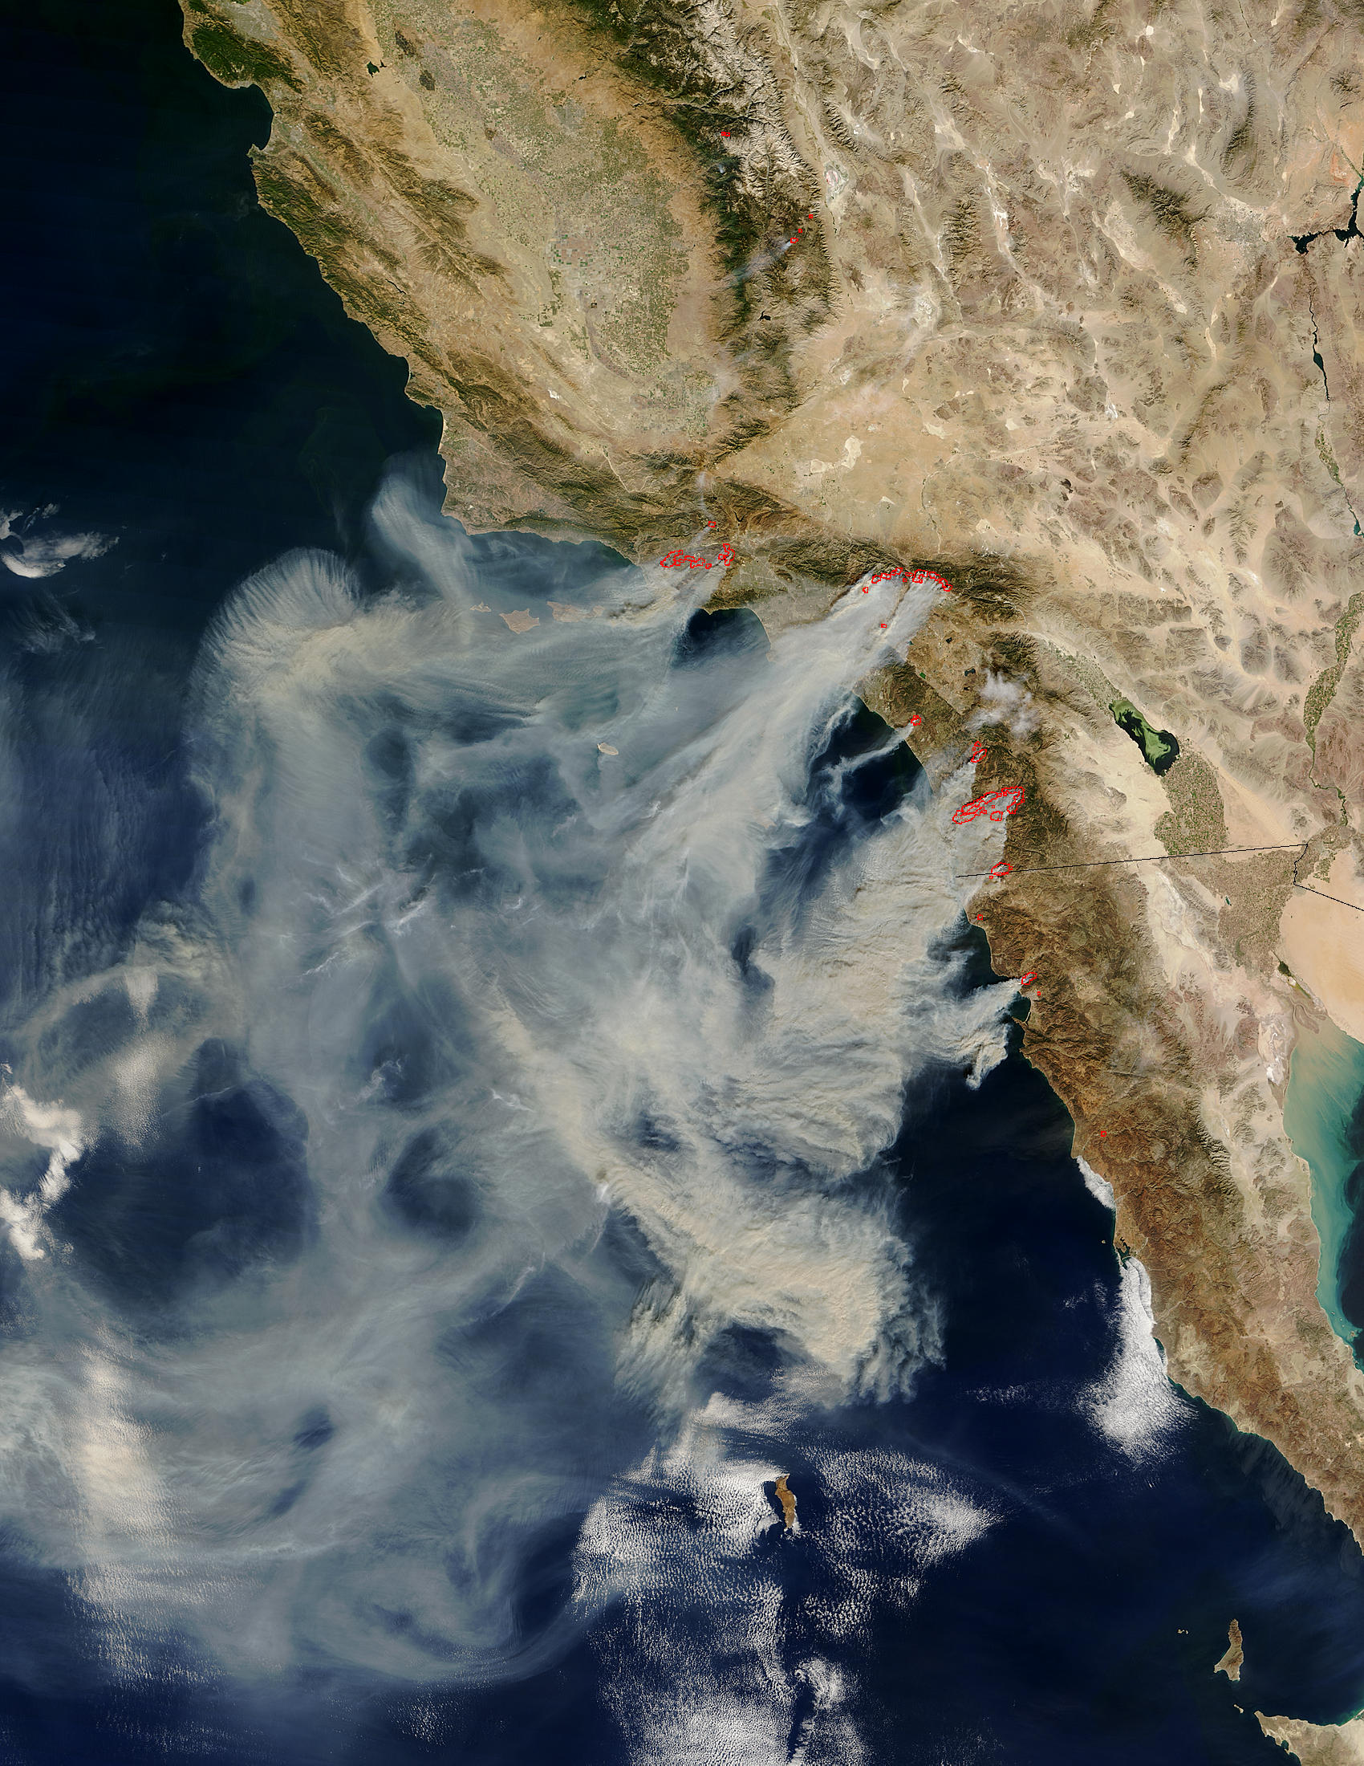
The Fire Siege of 2003
NASA/Goddard Space Flight Center Scientific Visualization Studio

Slide 6
TFPA History
Tribes went to Congress for legislation that would increase protection of tribal lands and resources throughout the United States.

Slide 7
TFPA History
The Tule River Tribal Council’s testimony for the TFPA stated:
“Every year we pray we are not the victims of catastrophic stand replacing fire, such as the devastation in Southern California.”
The Intertribal Timber Council’s testimony:
“applauds and strongly supports the Tribal Forest Protection Act.” It is “…a good opportunity to build partnerships that can produce results on the ground where they count.”
The TFPA passed in 2004 with bilateral support.

Slide 8
Key Terms
TFPA - Tribal Forest Protection Act of 2004
“Tribes”- refer to those tribal governments recognized by the federal government.
“Trust Responsibility”- the federal government has a legal responsibility to protect the interests and rights of Tribes and their members.
“Land in trust”- the US holds the legal title and the Tribe or individual Indian person holds the beneficial interest.
Notes:
.

Slide 9
TFPA Background
The TFPA authorizes the Secretaries of Agriculture and Interior to give special consideration to tribally-proposed projects on FS or Bureau of Land Management administered lands.

Slide 10
TFPA Basics
Emphasizes the government-to-government relationship between the federal government and Tribes.
Sets forth the goal for protection of trust lands.
Acknowledges Tribes’ historic and cultural interests.
Recognizes tribal relevant knowledge and skills.
See ITC TFPA handouts for specifics and details.

Slide 11
TFPA Basics
To qualify, the land (either tribal or allotted):
Must be in trust or restricted status and
Must be forested or have a grass, brush, or other similar vegetation, or
Formerly had a forest cover or vegetative cover that is capable of restoration.

Slide 12
TFPA Basics
The Tribe must propose a specific project to take place on FS (or BLM) administered land which:
Borders or is adjacent to Indian trust land and
Poses a fire, insect infestation, disease, and/or other threat to the Indian forest land or rangeland or a tribal community; or
Is in need of land restoration.

Slide 13
TFPA Basics
The FS administered area for the TFPA proposal:
Should present or involve a risk to a feature or circumstance unique to the proposing Tribe (e.g., a risk to treaty rights; or biological, archaeological, historical, or cultural features), and
Should not be subject to some other conflicting agreement or contract.

Slide 14
TFPA Basics
The FS may respond to tribal proposals (approve or deny) within 120 days.
While TFPA provides a lot of discretion to the agency, Executive Orders, agency policy and many protocol agreements encourage timely responses.
TFPA authorizes Forest Service & BLM to enter into contracts and/or agreements directly with the Tribe or consider tribally-related factors when selecting the contractor and/or cooperator.
Collaboration prior to the submission of a formal proposal contributes to success.

Slide 15
TFPA Basics
The FS can enter into an agreement or contract in response to the proposal with agency appropriated funds and/or other appropriate sources of funding.
Third parties may be involved in funding and doing the work on the ground.

Slide 16
TFPA Basics
For contracts, the FS can use “best value” and give special consideration to tribally-related factors such as, but not limited to:
The status of the Indian Tribe;
The trust status of the Tribe’s land;
The cultural, traditional, and historical affiliation of the Tribe with the land subject to the proposal.

Slide 17
Contracts and Agreements under The Tribal Forest Protection Act of 2004
Why is this authorized?
U.S. Government responsibilities & interests
Sovereign rights, Treaty & Trust responsibilities.
Forest Service mission and values.
Tribal rights and interests
Sovereign rights, Treaty rights & reserved rights.
Cultural, Natural and Economic values & interests.

Slide 18
Contracts and Agreements under The Tribal Forest Protection Act of 2004
How do we utilize the authority?
Contracts
Agreements

Slide 19
Contracts and Agreements under The Tribal Forest Protection Act of 2004
Selecting an Instrument
There are a variety of tools to choose from:
Stewardship Contracts (IRTCs and IRSCs)
Traditional Service Contracts
Traditional Timber Contracts
Participating Agreements
Challenge Cost-Share Agreements

Slide 20
Contracts and Agreements under The Tribal Forest Protection Act of 2004
Selecting an Instrument
Consider both parties’ needs and objectives:
What are the treatment objectives?
Are there requirements on how the work is executed?
Timing restrictions or objectives?
Economic needs to consider?
Labor workforce needs to consider?

Slide 21
Contracts and Agreements under The Tribal Forest Protection Act of 2004
Selecting an Instrument
Consider both parties’ resources:
Where is the money coming from?
Is there timber value?
How much appropriated funding? Is it the right kind?
Other sources of financial support? (Grants? Cooperators?)

Slide 22
Contracts and Agreements under The Tribal Forest Protection Act of 2004
Selecting an Instrument
Consider both parties’ resources:
Where is the labor and equipment coming from?
Does the Tribe have the manpower, organization & equipment to succeed? Part of it? All of it?
What does the local contractor pool look like?
Do other cooperators have manpower, equipment and organization to execute part or all of it?
If there is product removal, where is the material going to?

Slide 23
Contracts and Agreements under The Tribal Forest Protection Act of 2004
Consider the nature of the instruments:
Contracts – binding in nature, but Contractor may benefit greater financially.
Agreements – not binding; easy to change or terminate; may require match.
A comprehensive approach may also include a combination of tools.

Slide 24
Contracts and Agreements under The Tribal Forest Protection Act of 2004
AGREEMENTS
Stewardship Agreements
Traditional Agreements
Participating (20% match; specific work types; allows advance payments)
Challenge Cost-Share (20% match)
Collection
Other
Notes:
Participating Agreements: under two different aspects of the authority: Forestry Protection: This is the section where we focus on hazardous fuel reduction work, or other forestry related work. Job training/manpower development: we have a number of these agreements with tribes to host their training programs, particularly when it comes to fire crews or other natural resource work. OTHER Agreements may include agreements like Cooperative Fire Agreements.

Slide 25
Contracts and Agreements under The Tribal Forest Protection Act of 2004
AGREEMENTS CONSIDERATIONS:
What does TFPA do for Agreements?
Agency / Cooperator relationship.
Agreements are non-binding legal instruments.
Other requirements or restrictions (i.e. matching requirements, or specific activities or locations)
Tribe: Tribal Authority
Federal Government: Line Officers

Slide 26
Contracts and Agreements under The Tribal Forest Protection Act of 2004
CONTRACTS
Traditional contracts
Procurement Contracts (purchase services)
Timber Contracts (sell goods)
Stewardship Contracts (trade goods for services)
Integrated Resource Timber Contracts (IRTCs)
Integrated Resource Service Contracts (IRSCs)
Service Stewardship Contracts
Notes:
Stewardship contracts – trade goods for services.

Slide 27
Contracts and Agreements under The Tribal Forest Protection Act of 2004
CONTRACTS
Timber Contracts (income)
Timber Contracts (income to US Treasury)
Integrated Resource Timber Contracts (IRTCs)
Procurement Contracts (expenditure)
Traditional Service Contracts
Integrated Resource Service Contracts (IRSCs)
Service Stewardship Contracts
Notes:
Timber contract: money to Treasury; IRTC: retained receipts.
Service Stewardship contracts: FS can utilize retained receipts

Slide 28
Contracts and Agreements under The Tribal Forest Protection Act of 2004
CONTRACTING CONSIDERATIONS:
Contracting Agency / Contractor relationship.
Contracts are binding legal instruments.
Sovereign Immunity & the business transaction.
Tribe: Tribal Authority
Federal Government
Procurement Contracting Officer (IRSCs & Service)
Timber Contracting Officer (IRTCs & Timber Sales)

Slide 29
Contracts and Agreements under The Tribal Forest Protection Act of 2004
CONTRACTING:
How does TFPA fit in the framework of other federal contracting regulations?
Non-competitive: TFPA authorizes the Agency to contract directly with a tribe if the conditions stated in the Act are met.
Competitive. TFPA authorizes the use of tribally-related evaluation factors.

Slide 30
Contracts and Agreements under The Tribal Forest Protection Act of 2004
CONTRACTING:
How does TFPA fit in the framework of other federal contracting regulations?
Non-competitive:
Federal Acquisition Regulations (FAR): FAR 6.302-5: Authorized or Required by Statute.

Slide 31
Contracts and Agreements under The Tribal Forest Protection Act of 2004
Non-Competitive Process (Procurement):
Project approved.
“Pre-solicitation” meetings with Tribe.
Evaluation Criteria selected, if relevant.
Draft solicitation.
Issue solicitation to selected Tribe.
Pre-proposal conference.
Receive and evaluate proposal.
Award Contract.
Pre-work Meeting / Start Work.

Slide 32
Contracts and Agreements under The Tribal Forest Protection Act of 2004
CONTRACTING:
How does TFPA fit in the framework of other federal contracting regulations?
Competitive: TFPA authorizes the Government to use “Best Value” contracting to make the award decision.

Slide 33
Contracts and Agreements under The Tribal Forest Protection Act of 2004
CONTRACTING ISSUES:
How does TFPA fit in the framework of other federal contracting regulations?
Competitive: The normal use of evaluation criteria in our competitive solicitations frequently includes the following evaluation factors:
Technical Approach
Past Performance (required by FAR)
Benefits to Local Community (specific authorities for stewardship and hazardous fuels reduction)

Slide 34
Contracts and Agreements under The Tribal Forest Protection Act of 2004
CONTRACTING ISSUES:
How does TFPA fit in the framework of other federal contracting regulations?
Competitive: TFPA authorizes the use of additional “Proposal Evaluation & Determination Factors”
Status of Indian tribe as an Indian tribe
Trust status of the Indian forest land or rangeland of the tribe
Cultural, Traditional, historical affiliation with the land
Treaty rights or reserved rights associated with the land
Indigenous knowledge and skills of tribe
Features of the landscape of the land, incl. watersheds & veg.
Working relationship between tribe and Agencies in coord. activities.
The access by members of the tribe to the land.

Slide 35
Contracts and Agreements under The Tribal Forest Protection Act of 2004
Competitive Process (Procurement):
Project approved.
Evaluation Criteria selected.
Draft solicitation.
Issue (advertise) solicitation.
Pre-proposal conference.
Receive and evaluate proposals.
Award Contract.
Pre-work Meeting / Start Work.

Slide 36
Contracts and Agreements under The Tribal Forest Protection Act of 2004
TAKE HOME MESSAGES
The FS can enter into contracts or agreements directly with the Tribe when certain criteria are met.
Stewardship contracts/agreements are not mandatory for TFPA projects, but may have advantages that make them useful vehicles for carrying out TFPA projects.
The agency has discretion in awarding contracts and may use a variety of competitive or non-competitive processes.
The Agency may use a “Best Value” evaluation process for contract award, and must use that process for stewardship contracting.

Slide 37
Questions or comments?

